Slide 1
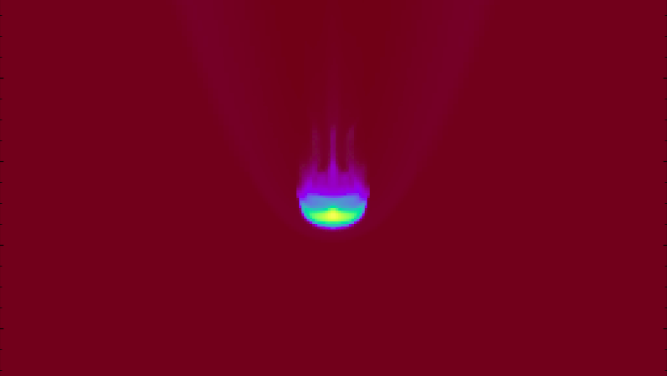
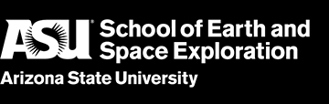



Simulating Galaxy Outflows in the Circumgalactic Medium
ghuckabe@asu.edu
Gabriela Huckabee
SESE Thesis Defense
1 March 2019
Defense Committee: Joseph Foy, Evan Scannapieco, Rolf Jansen

Slide 2
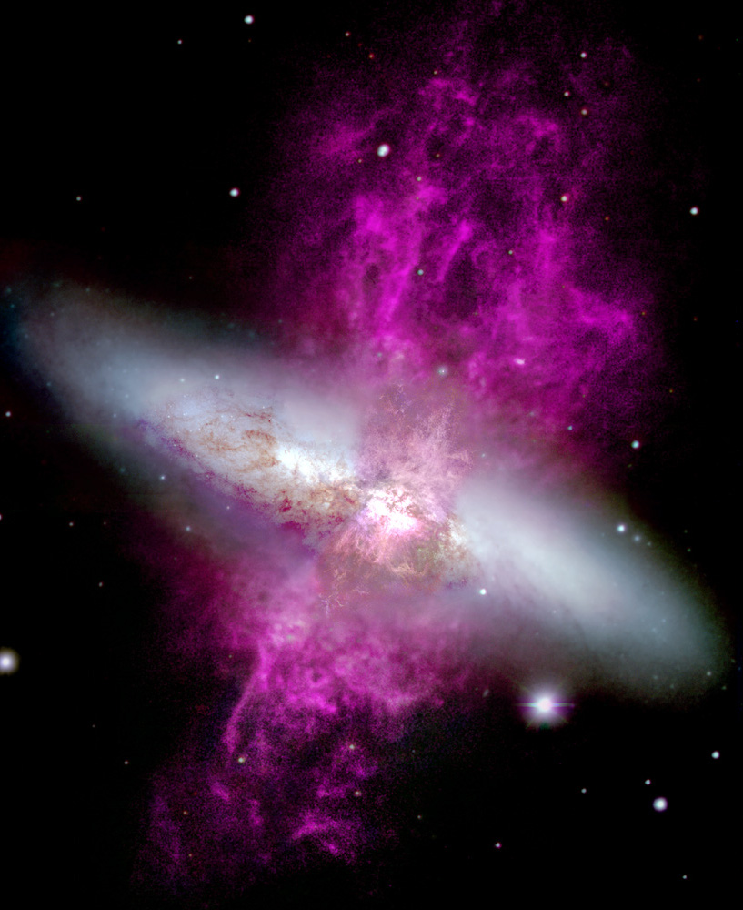

Introduction - Circumgalactic Medium
Circumgalactic Medium (CGM)
~0.1 kpc
~30 kpc
300 kpc
Hɑ outflows in M82 taken by WIYN
Notes:
Wisconsin, indiana, yale, noao consortium cgm is abt 300 kpc in radius
Gravitationally bound region around galaxies
Source of material for star formation and accretion

Slide 3
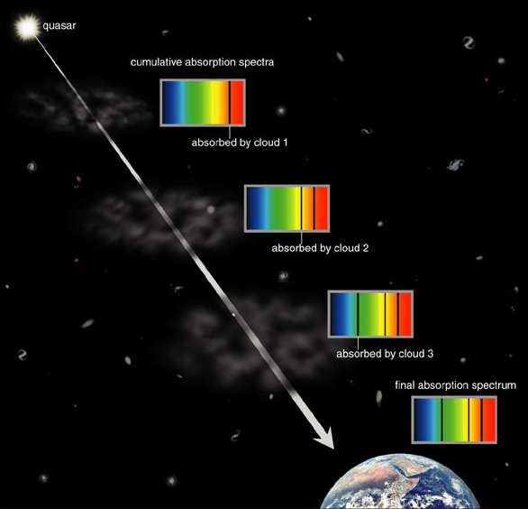
Introduction - Quasi-Stellar Object (QSO) Spectra
Graphic made by Addison Wesley from Pearson Education.
Notes:
Qso absorption, emit a continuum, foreground cgm absorbs lights

Slide 4
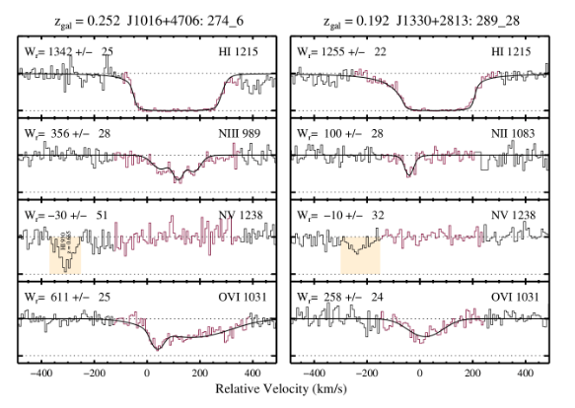
Introduction - Cosmic Origins Spectrograph (Hubble)
COS is an instrument on the Hubble Space Telescope that collects spectra
Presence of nitrogen species like NII and NIII - nitrogen exists in CGM
Presence of OVI means ions with lower potentials like NV should be present
?
?

Slide 5
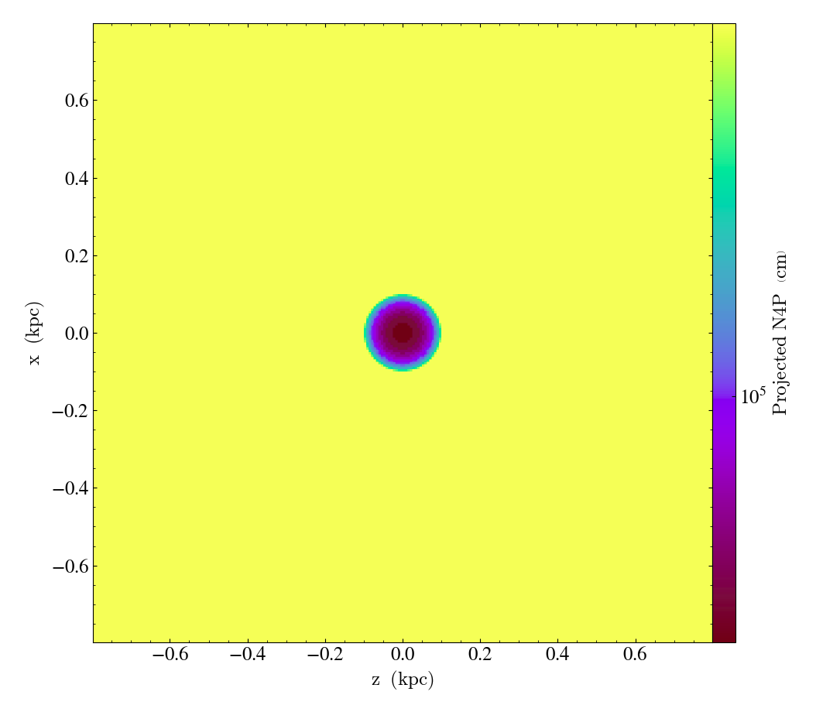
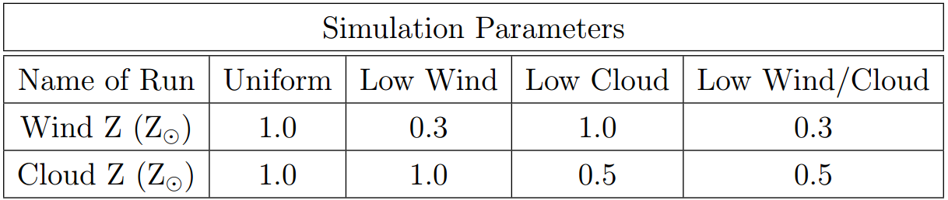
Methods - Nonuniform Initial Metallicity
Cloud Metallicity
Wind Metallicity

Slide 6
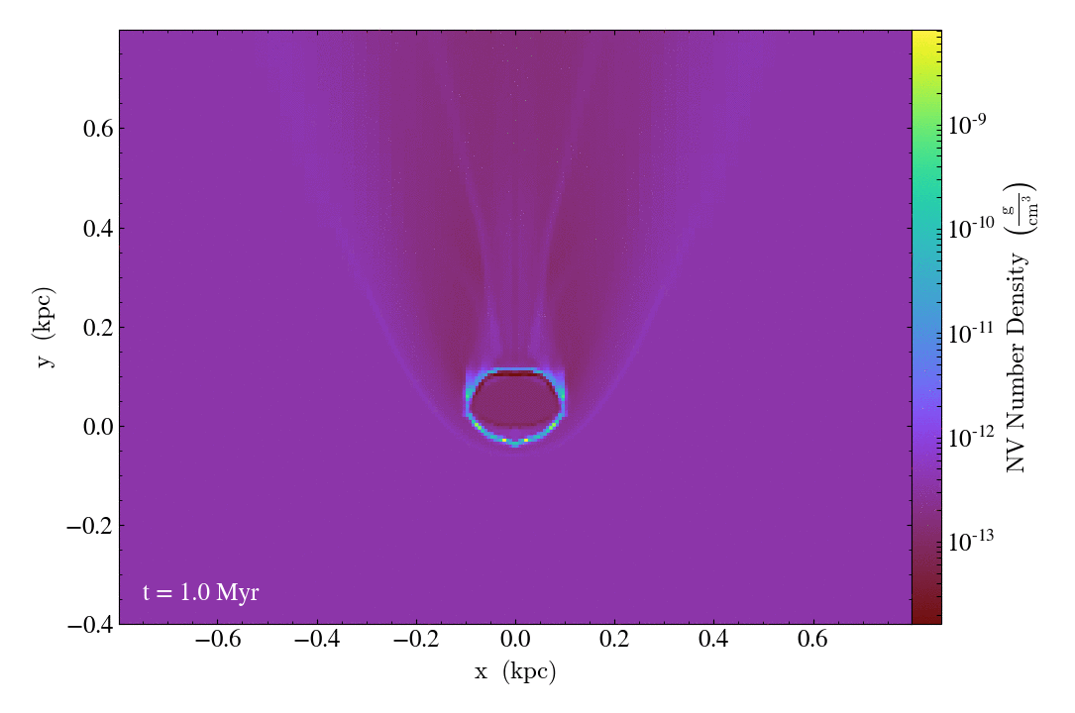
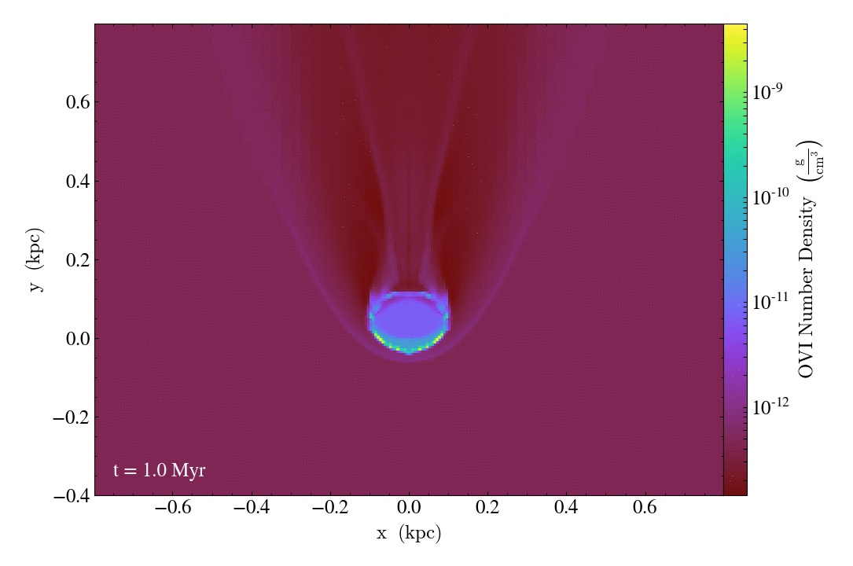
Results - Slice plots
Uniform Run
NV number density
Uniform Run
OVI number density

Slide 7

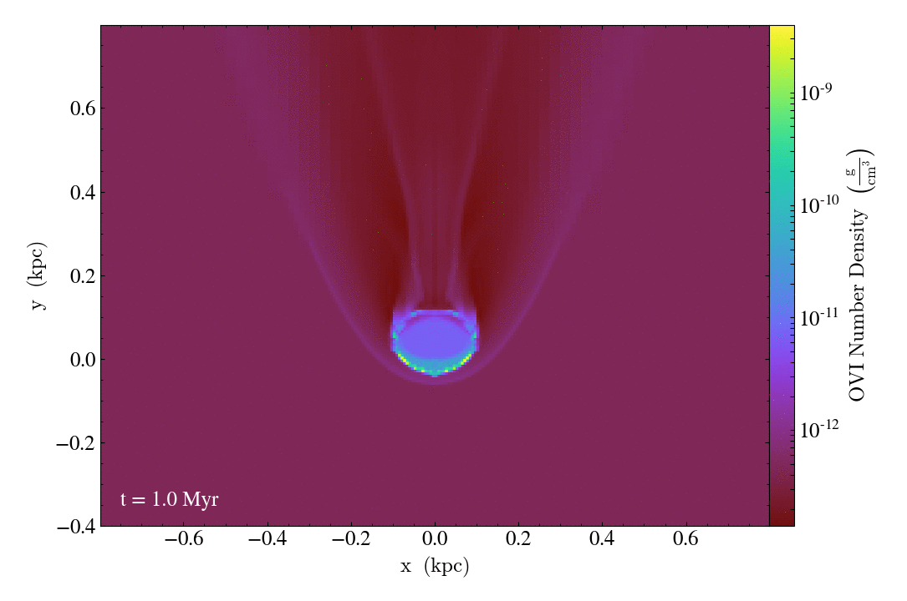
Results - Slice Plots
Low wind/cloud Run
NV number density
Low wind/cloud Run
OVI number density

Slide 8
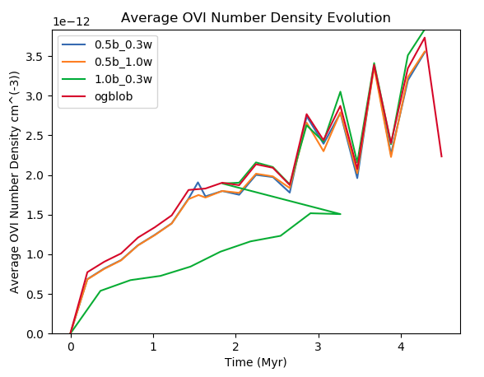
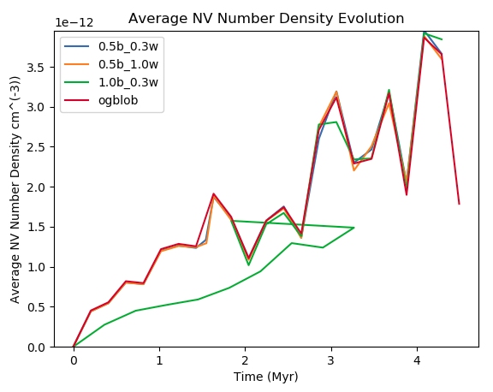
Results - Number Density Evolution

Slide 9
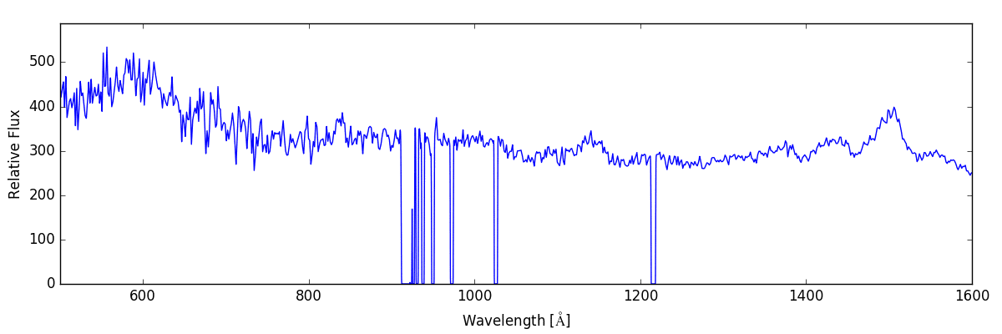
Results - Spectra
Spectra from uniform run from checkpoint 0 to 20

Slide 10
Further Study
Add in magnetic fields (J’Neil Cottle is doing this currently!)
Find cause of coincidence in number densities (read-in error? Plotting incorrectly?)
Make higher resolution spectra
Make spectra code usable on supercomputer (fix imports)
Run longer, high-res simulations across the parameter space, setting checkpoints to output based on simulation time

Slide 11
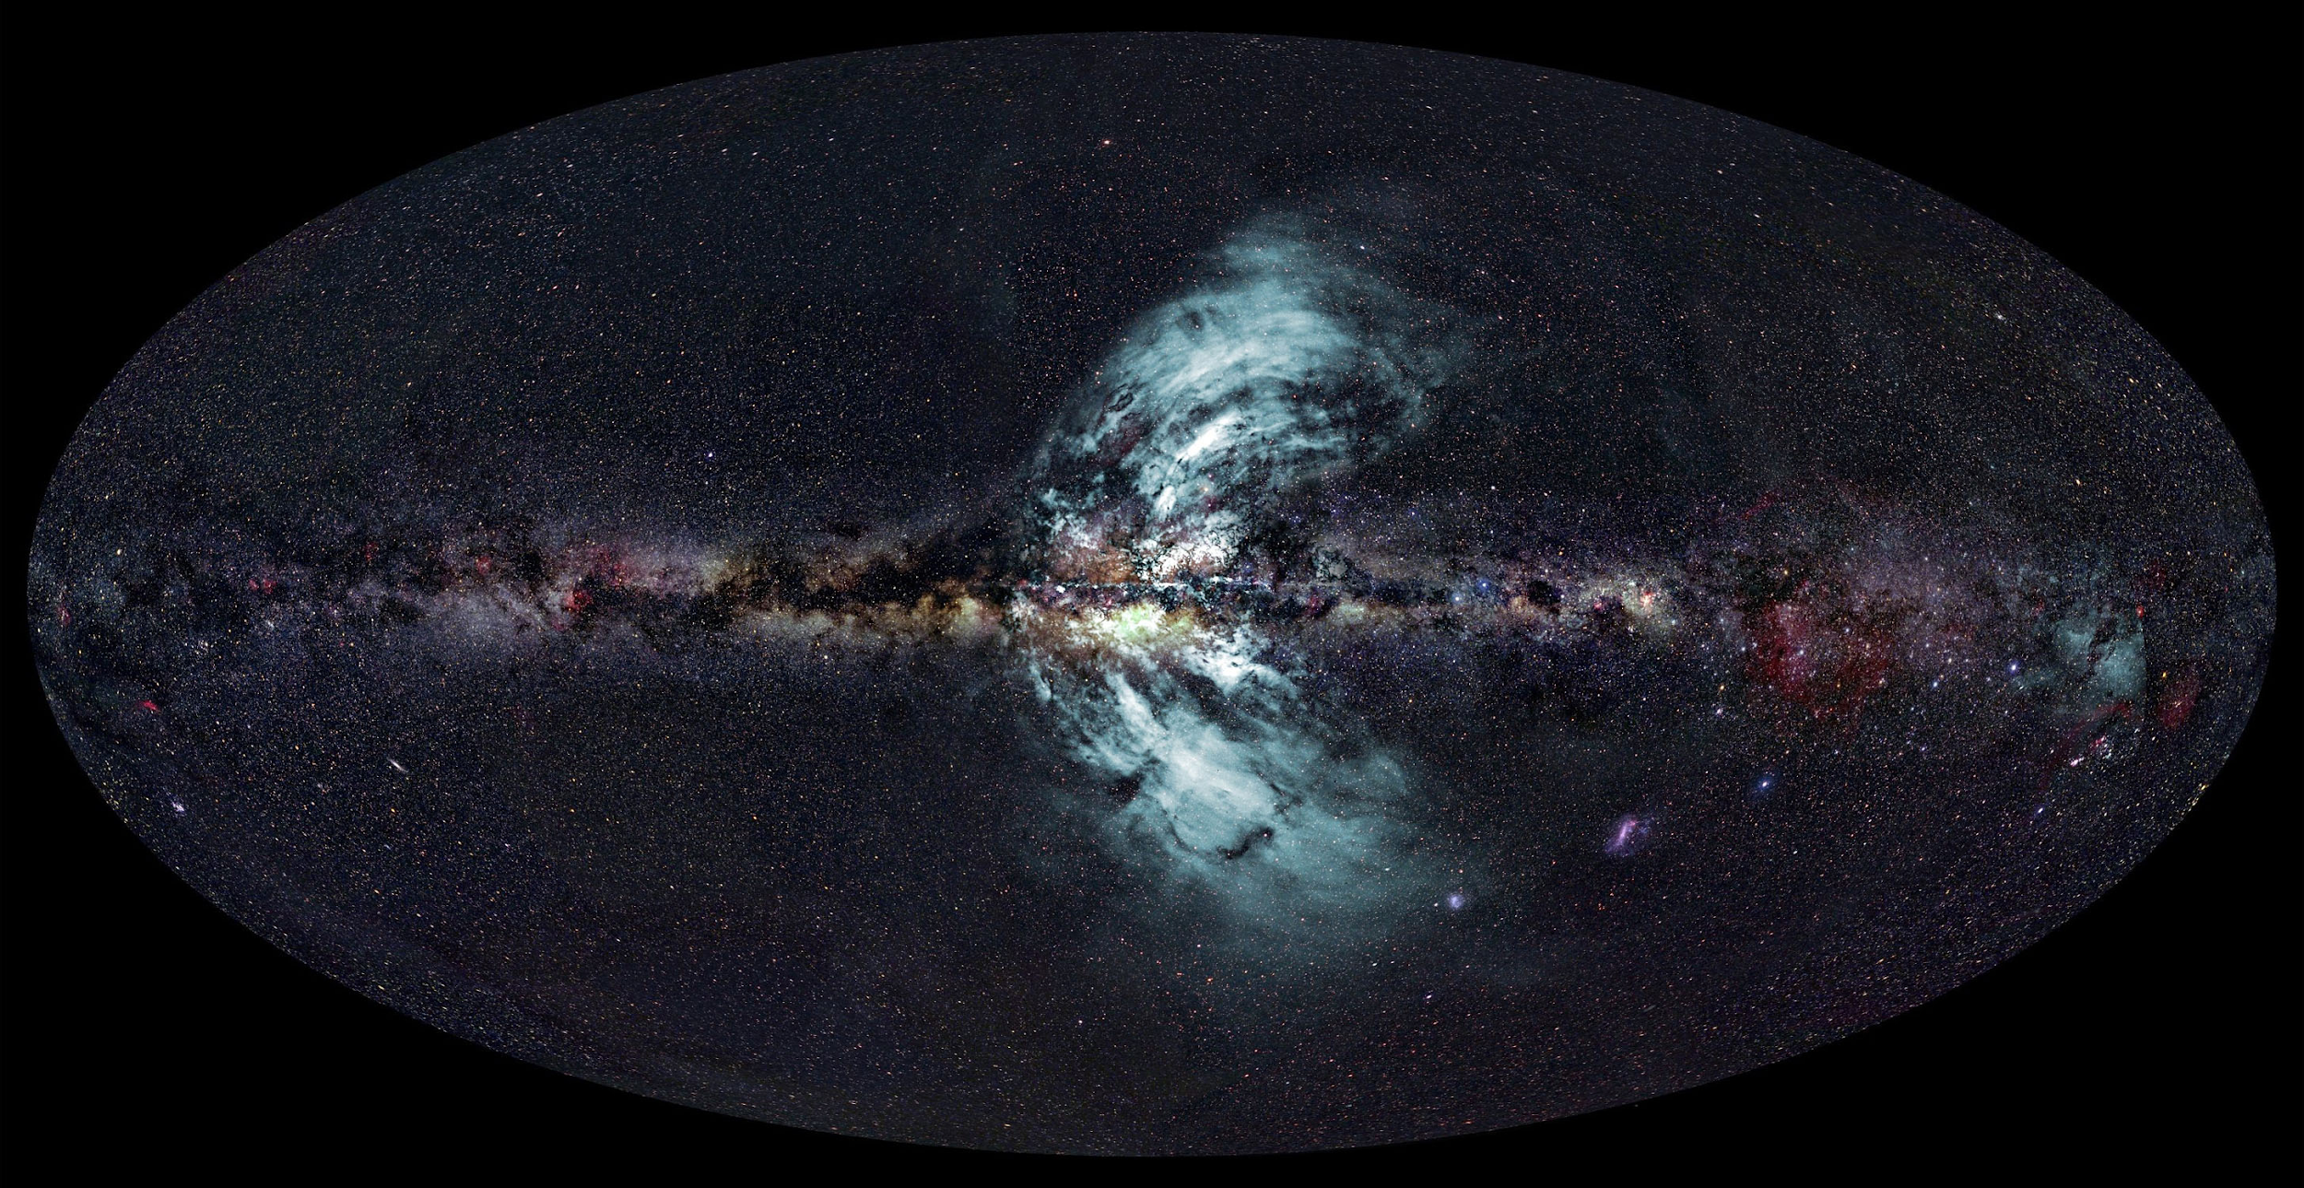
Contact me at ghuckabe@asu.edu
Summary
CGM simulations are slowly being improved
Metallicities may not be read into simulation correctly
NV is too abundant - simulations are not complete!
Need high-res, longer simulations
Metallicity is computationally inexpensive, and changes results slightly
Credits: Ettore Carretti, CSIRO (radio image); S-PASS survey team (radio data); Axel Mellinger, Central Michigan University (optical image); Eli Bressert, CSIRO (composition)
Acknowledgements
Joseph Foy, Evan Scannapieco, and Rolf Jansen for being by thesis advisors
J’Neil Cottle and Evan Scannapieco for serving as primary mentors on this project and conducting the projects that led to this one
Edward Buie II and William Gray for helping set up the non-equilibrium chemistry in this simulation and troubleshoot the chemistry errors

Slide 12
References
Brüggen, M., & Scannapieco, E. 2016, The Astrophysical Journal, 822, 31
F Lang, P., & C Smith, B. 2013, TheScientificWorldJournal, 2013, 157412
Fryxell, B., Olson, K., Ricker, P., et al. 2000, The Astrophysical Journal Supplement Series, 131, 273
Gray, W. J., & Scannapieco, E. 2016, The Astrophysical Journal, 818, 198
Gray, W. J., Scannapieco, E., & Kasen, D. 2015, The Astrophysical Journal, 801, 107
Hummels, C. B., Smith, B. D., & Silvia, D. W. 2017, The Astrophysical Journal, 847, 59
Lochhaas, C., Mathur, S., Frank, S., et al. 2018, arXiv preprint arXiv:1809.09122
Scannapieco, E., & Br ̈uggen, M. 2015, The Astrophysical Journal, 805, 158
Scannapieco, E., Br ̈uggen, M., et al. 2018, The Astrophysical Journal, 864, 96
Tumlinson, J., Peeples, M. S., & Werk, J. K. 2017, Annual Review of Astronomy and Astrophysics, 55, 389
Werk, J. K., Prochaska, J. X., Cantalupo, S., et al. 2016, The Astrophysical Journal, 833, 54

